Slide 1
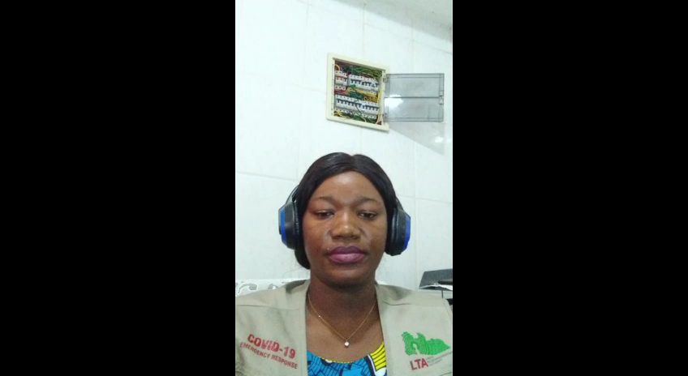
IMPORTANCE OF BUILDING COMMUNITY NETWORK
May 7, 2020
How can we make a difference?
  Sangai P. Moliwulo
  Technical Analyst
  Liberia Telecommunications Authority
    moliwulo@isoc.org

Slide 2

OUTLINE
Introduction
Objective
Liberia Digital Report
What is Community Network?
Why is community Network Important?
Why do we need more Community Network Liberia?
What do we have to do?
What is Viability Study?
Challenges
Good Luck

Slide 3
INTRODUCTION
To make the Internet Society’s goal of making internet available for everyone, everywhere a reality, it is important we understand the importance of Building Community Network.
Half of the world population is unconnected to the internet, mainly in least developed countries in Africa, and Liberia is no exception.

Slide 4
OBJECTIVE
The objective of this presentation is to create young community leaders who will take charge of creating awareness and express willingness to collaborate with their chapter to achieve the Internet Society’s vision of making internet available to everyone, everywhere a reality.
We can bridge the digital divide and serve the underserved by helping to provide affordable and accessible internet using our skills.

Slide 5
LIBERIA DIGITAL REPORT
According to datareportal.com, as of January 2020 the number of internet users in Liberia were 624.6 thousand and internet penetration stood at 12%.
The same source reported that there were 530.0 thousand social media users and that social media penetration stood at 11% at the same time.
However, there are 4.13 million mobile connection in Liberia as of January 2020. The number of mobile connections is equivalent to 83% of the total population . Liberia population is 4.92 million as of the last censors.
For more information click. https://datareportal.com/reports/digital-2020-liberia

Slide 6
WHAT IS COMMUNITY NETWORK?
According to the Internet Society, community networks are complementary access networks. They provide local access where traditional or commercial networks do not reach or serve particular areas, or where commercial operators do not find it economically efficient to operate in particular areas.
They are “do It yourself” networks built by people for people or initiated by third parties like NGOs.

Slide 7
WHY IS COMMUNITY NETWORK IMPORTAN?
There are several reasons why Community Network is important here are few:
Community Network is important because it about humanity, people, their lives and their communities. Access to affordable internet stimulates economic activities and create opportunities for small business.
Community networks provide access to information and the sharing of.
Community Network encourages people to collaborate for the good of their community.

Slide 8
WHY DO WE NEED MORE COMMUNITY NETWORK IN LIBERIA?
Most regions especially the rural areas in Liberia are not connected or cannot afford to be connected to the internet; the reason is, they lack commercial viability. ISPs will not roll out networks for internet access to areas with less economic value and also low population but high deployment cost.

Slide 9
WHAT DO WE HAVE TO DO?
Communities must be willing to collaborate in putting their resources together to get connected. E.g. financial and other assets like lands and buildings.
Be granted permission: The Regulations on Community Network is different from regular ISPs, they do not need to go through the same licensing procedure like ISPs because they do not have the resources and are non-profit in nature. Therefore Community Network can be classified as network for self provisioning services or network offering services to third parties.
Get Technical Assistant: A technical assistant will be able give you a full Viability Study.

Slide 10
WHAT IS A VIABILITY STUDY
A Viability Study should be able to tell you,
What Physical infrastructure is available- where to build an antenna eg. Hills or high roof top
What Technical infrastructure is available- technical equipment needed for your setup. Eg. cables
Where is the closest source of Power/Electricity- nearest power station or you could use solar energy
Where is the closest source of Internet- nearest distance away from internet source. Eg use cable or Macro wave link

Slide 11
CHALLENGES
We currently do not have any specific regulations in Liberia on Community networks though community networks critically rely on the availability of spectrum; Ensuring that adequate spectrum is available for community networks is a key policy principle for expanding Internet access.
• Spectrum is viewed as scarce. Instead of focusing on the scarcity of spectrum, we should consider spectrum to be a common resource to be managed efficiently and effectively since it is a public resource.
Traditional regulations: Regulators often favor exclusive and broad licenses, which can result in lack of coverage in some areas and fewer options for multiple and innovative service provision and spectrum usage

Slide 12
CHALLENGES CONT.
Access to spectrum is expensive. Spectrum rights come at high costs. For example, many regulators auction spectrum rights to the highest bidder, and many charge high regulatory fees for spectrum. Often, community networks do not have the funding or financial ability to pay for spectrum rights. Furthermore, because incumbent service providers have made sizeable investments in obtaining spectrum rights, they often have an expectation of exclusive use of that spectrum that is difficult to combat.

Slide 13
  GOOD LUCK IN BRINGING INTERNET TO OUR COMMUNITIES
  THANK YOU

